Slide 1
Group 3 Architectural Spike
SKY RACERS
Thomas Gadek, Nicholas Knowles, Emmanuel Owusu, Jeffrey Perreault, Timothy Scott

Slide 2
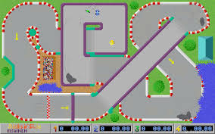
Cycle Intent
Proof of concept for all main elements needed to develop a racing game. This includes object movement, barriers, sound, and physics.
Develop a demo of these concepts

Slide 3
Initial goals
Import and display images in a window
Control image movement with user input
Play continuous sound, and sound based on user input
Perform basic and complex collision checking (and edge detection)
Allow a user to import custom tracks with more than one layer (bridges)

Slide 4
What was scrapped
Development using Java
The team found that Pygame was easier to work with
Collision points based on color of the map
A better implementation for collision was found
Processing for physics
Lacked compatibility cross platform

Slide 5
Plan
Original plan
Try using Java and pygame to decide best language for implementation.
Create a very minimal racing game with the main elements needed.
Actual plan
Chose Pygame as best language
Use as many elements as possible to make a map/collision/sound demo, a VM demo, and a Box2D collision/interaction demo

Slide 6
Features
Custom map input
Complex Collision
Sound
Assembler
VM

Slide 7
Features
Name: Custom map import
Feature: Allows a user to create a 1024x768 custom map and import it into the game.
Constraints: The user has to input the correct size images using the correct naming convention for the application

Slide 8
Features
Name: Complex Collision
Feature: Player model will stop and change color when it collides with the collision points. This collision is pixel perfect.
Constraints: Due to the mouse coordinate being the current input method, traveling through walls is possible since the user can continue dragging the mouse during a collision. A simple input change to keyboard will fix this.

Slide 9
Features
Name: Assembler
Feature: Assembles custom assembly language to bytes
Constraints: Does not handle unrecognized commands

Slide 10
Features
Name: Sound
Feature: Game plays sounds based on situations like car/barrier collisions.
Constraints: None

Slide 11
Features
Name: VM
Feature: The VM takes binary text code and performs actions based on the binary code.The VM currently has the ability to go around the track with no user input.
Constraints: Currently no user input if needs to be interrupted.

Slide 12
Demo 1 Design
Inputs: PNG of visual map, collision map, and top layer
Name convention for all associated PNGs <map name>_<type>.png
Only one input for map name required, all maps can be found using convention
Uses mouse coordinates for player location
Easy to demonstrate collision
Plays sound on collision

Slide 13

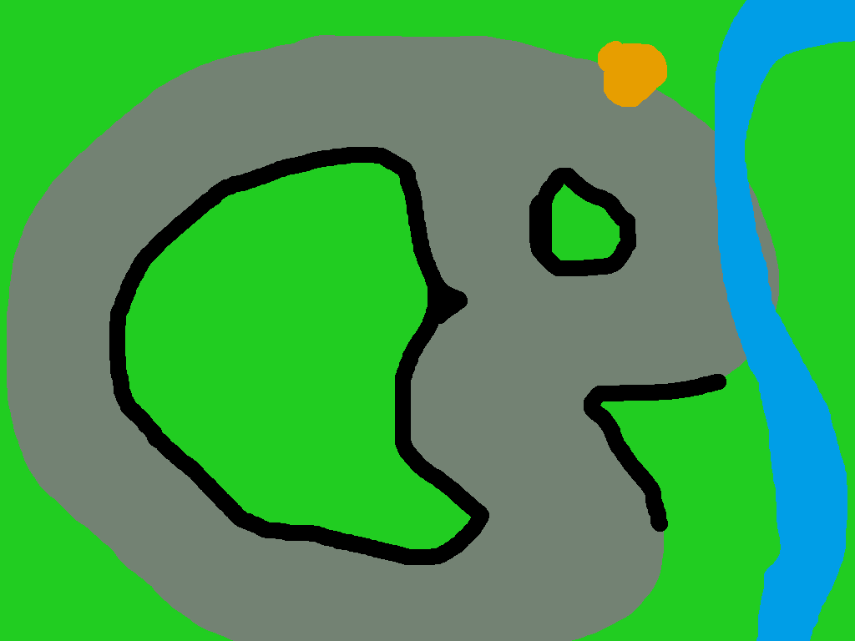

Demo 1 Design:
Collision map Map picture Map top layer picture
map2_coll.png map2_pic.png map2_top.png

Slide 14
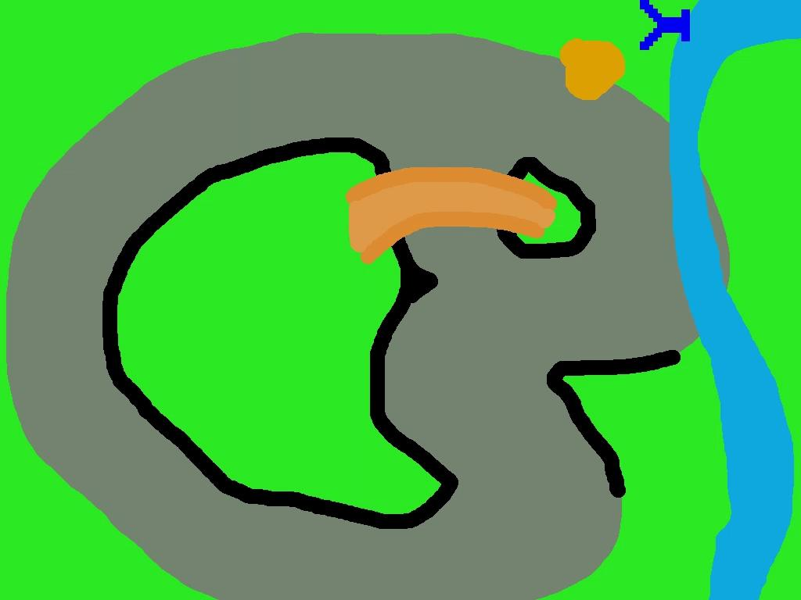
Demo 1

Slide 15

Demo 2 ANIMATION
The sky with motion of clouds is the background of the game.
Makes the game more realistic and appealing to the eye of the user and makes them want to explore.
SKY
RACERS

Slide 16
Design
This demo shows the collision map, map picture and map layer top picture with a motion of the sky with clouds as the background.
The motion background adds more fascination to the game and makes it more lively.

Slide 17
Demo 3 Design
Inputs: PNG image of a visual map and a car
Uses coordinates to know the car’s location and trigonometry for angled movement and direction.
Good for VM based movement
Makes it around the track with only VM input

Slide 18
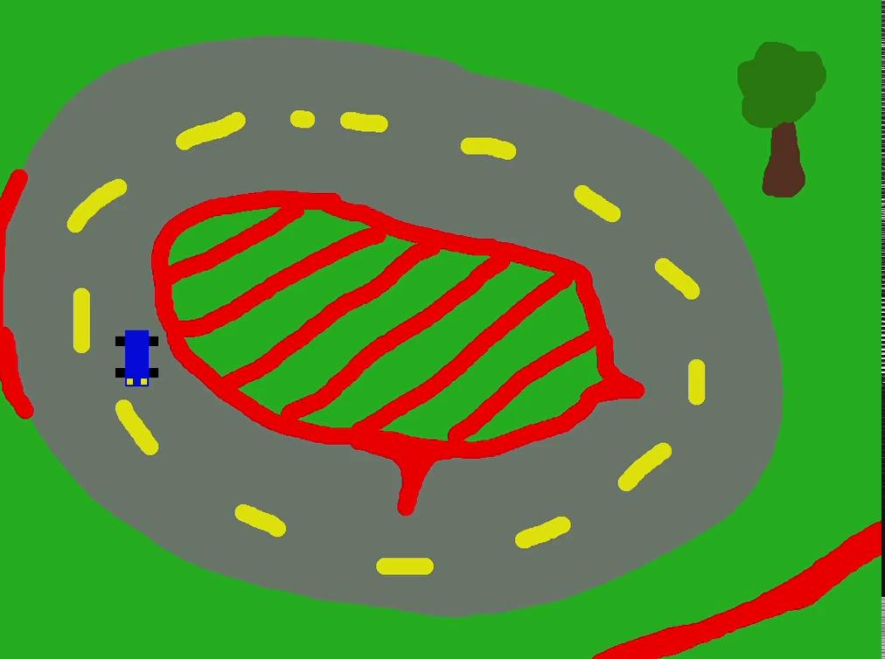
Demo 3

Slide 19
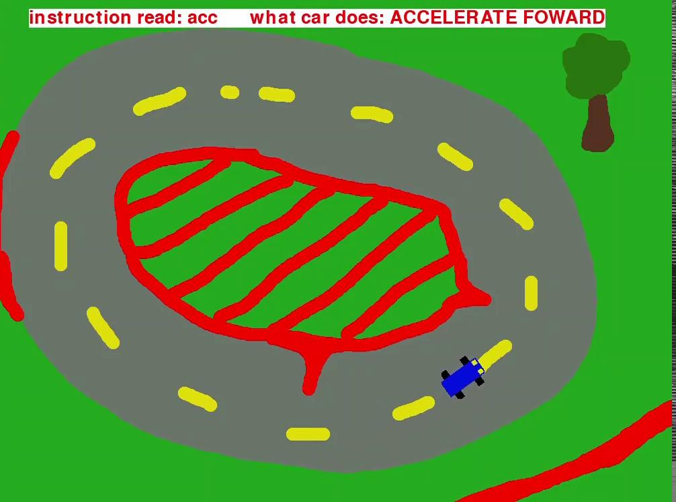
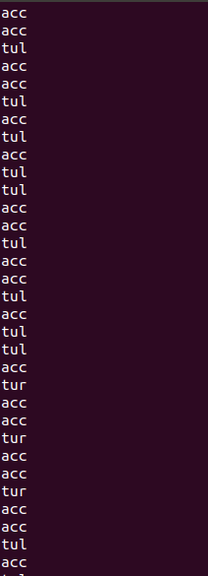
Demo 3 continued
An example of the car takes directions from the input on the right.
Adjusted FPS for this demo*

Slide 20
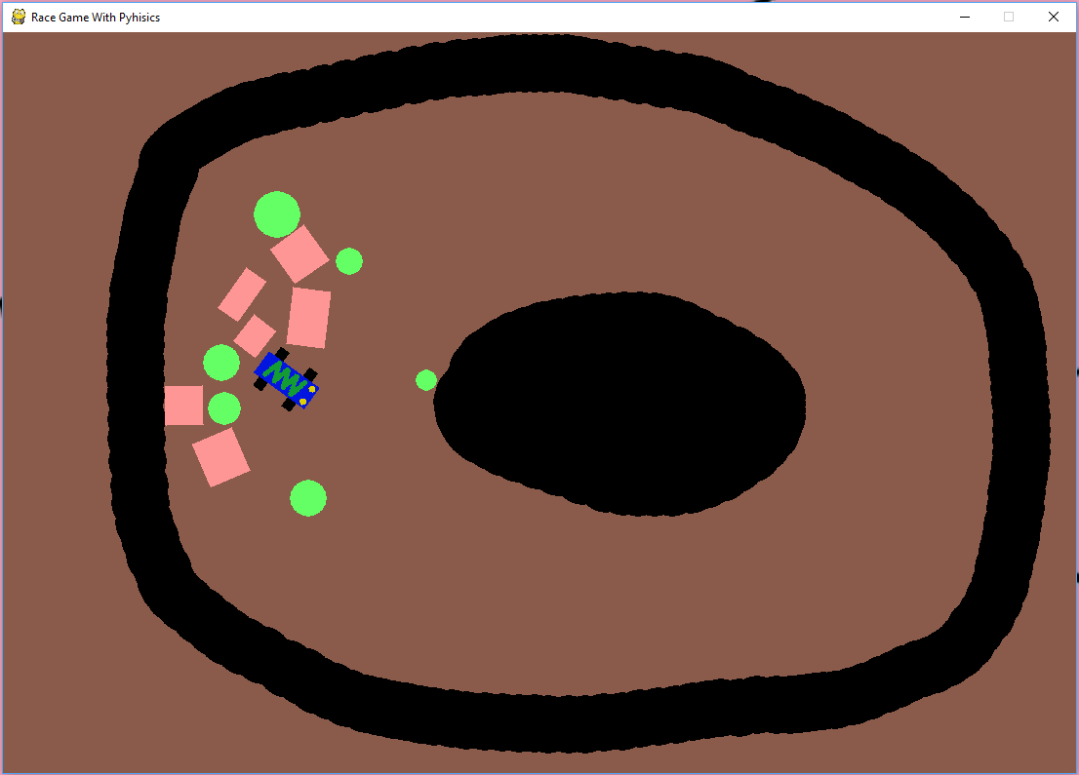
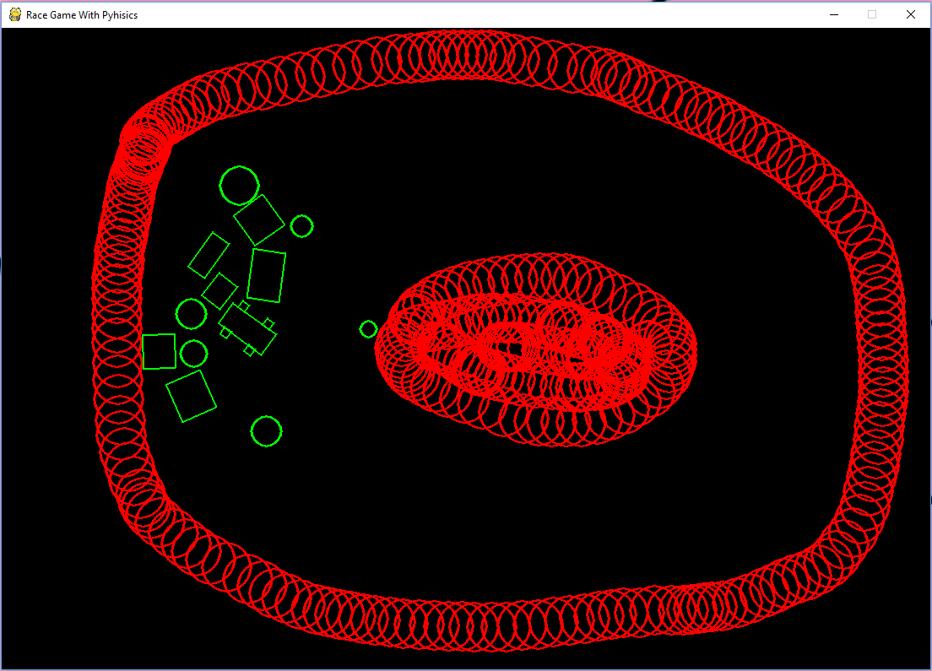
Demo 4
What the user sees what the physics engine sees

Slide 21
Demo 4 Design
-loads PNG Images of the car and map
-Uses mouse coordinates for placing objects
-Uses keyboard inputs to control the car
-Shows how a physics engine can be used for realistic collision detection and collision resolution

Slide 22
Process/Tools/Standards
Bitbucket was used for code management and organization
Team members were each tasked with a few key elements to develop
Using working elements members were each tasked with developing a higher implementation of each for demo purposes
Overall there was not process/standard, it was mostly a free for all

Slide 23
Lessons learned
Became more familiar with pygame
Image import/display, sound, user input
Tying it all together
Simple assembler and VM development
Create custom asm language with assembler
Create a VM that uses the binary output of assembler to control an application
Git repo contribution and management

Slide 24
What’s next
In the future we will be going more in dept with the animation. For example: Showing when the car crashes, show when it drifts and more.
For the first cycle, our goal is to get a working demo of a car that’s able to drive around the track with the collision points in place that the car can interact with, as well as implementing some sound effects.
For the second cycle our goal is to implement some form of checkpoints, with a working physics engine for drifting, and some kind of lap timer.
For the third cycle, we should be able to have two cars able to drive at once, one being a player controlled car and one being an AI controlled car.
By the end, we believe that we can tie all these elements together to get a game where you can input a custom map, with custom cars, and a custom assembly language file to control the AI cars.

